Slide 1
Unit 2
S-7 | SLO-1 | PMOS,NMOS
 | SLO-2 | CMOS Logic

Slide 2
nMOS Transistor
Four terminals: gate, source, drain, body
Gate – oxide – body stack looks like a capacitor
Gate and body are conductors
SiO₂ (oxide) is a very good insulator
Called metal – oxide – semiconductor (MOS) capacitor
Even though gate is
no longer made of metal

Slide 3
nMOS Operation
Body is usually tied to ground (0 V)
When the gate is at a low voltage:
P-type body is at low voltage
Source-body and drain-body diodes are OFF
No current flows, transistor is OFF

Slide 4
nMOS Operation Cont.
When the gate is at a high voltage:
Positive charge on gate of MOS capacitor
Negative charge attracted to body
Inverts a channel under gate to n-type
Now current can flow through n-type silicon from source through channel to drain, transistor is ON

Slide 5
pMOS Transistor
Similar, but doping and voltages reversed
Body tied to high voltage (V_{DD})
Gate low: transistor ON
Gate high: transistor OFF
Bubble indicates inverted behavior

Slide 6
Power Supply Voltage
GND = 0 V
In 1980’s, V_{DD} = 5V
V_{DD} has decreased in modern processes
High V_{DD} would damage modern tiny transistors
Lower V_{DD} saves power
V_{DD} = 3.3, 2.5, 1.8, 1.5, 1.2, 1.0, …

Slide 7
Transistors as Switches
We can view MOS transistors as electrically controlled switches
Voltage at gate controls path from source to drain

Slide 8

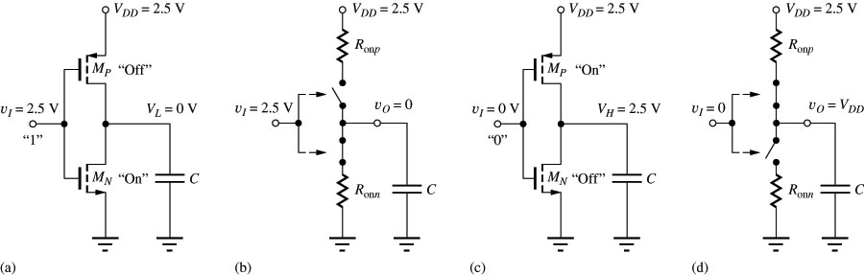

Static States of the CMOS Inverter
The capacitor discharges through R_{onN} , current exists only during discharge, no dc current exists.

Slide 9
Static States of the CMOS Inverter
The capacitor discharges through R_{onN} , current exists only during discharge, no dc current exists.

Slide 10
Static States of the CMOS Inverter
The capacitor discharges through R_{onN} , current exists only during discharge, no dc current exists.

Slide 11
Static States of the CMOS Inverter
The capacitor discharges through R_{onN} , current exists only during discharge, no dc current exists.

Slide 12
Static States of the CMOS Inverter
The capacitor discharges through R_{onN} , current exists only during discharge, no dc current exists.

Slide 13
Static States of the CMOS Inverter
The capacitor discharges through R_{onN} , current exists only during discharge, no dc current exists.

Slide 14
Static States of the CMOS Inverter
The capacitor discharges through R_{onN} , current exists only during discharge, no dc current exists.

Slide 15
Static States of the CMOS Inverter
The capacitor discharges through R_{onN} , current exists only during discharge, no dc current exists.

Slide 16
Static States of the CMOS Inverter
The capacitor discharges through R_{onN} , current exists only during discharge, no dc current exists.

Slide 17
Static Characteristics of the CMOS Inverter
The capacitor discharges through R_{onN} , current exists only during discharge, no dc current exists.
The capacitor charges through R_{onP} , current exists only during charging, no dc current exists.

Slide 18
Static Characteristics of the CMOS Inverter
The capacitor discharges through R_{onN} , current exists only during discharge, no dc current exists.
The capacitor charges through R_{onP} , current exists only during charging, no dc current exists.

Slide 19
Static Characteristics of the CMOS Inverter
The capacitor discharges through R_{onN} , current exists only during discharge, no dc current exists.
The capacitor charges through R_{onP} , current exists only during charging, no dc current exists.

Slide 20
Static Characteristics of the CMOS Inverter
The capacitor discharges through R_{onN} , current exists only during discharge, no dc current exists.
The capacitor charges through R_{onP} , current exists only during charging, no dc current exists.

Slide 21
Static Characteristics of the CMOS Inverter
The capacitor discharges through R_{onN} , current exists only during discharge, no dc current exists.
The capacitor charges through R_{onP} , current exists only during charging, no dc current exists.

Slide 22
Static Characteristics of the CMOS Inverter
The capacitor discharges through R_{onN} , current exists only during discharge, no dc current exists.
The capacitor charges through R_{onP} , current exists only during charging, no dc current exists.

Slide 23
Static Characteristics of the CMOS Inverter
The capacitor discharges through R_{onN} , current exists only during discharge, no dc current exists.
The capacitor charges through R_{onP} , current exists only during charging, no dc current exists.

Slide 24
Static Characteristics of the CMOS Inverter
The capacitor discharges through R_{onN} , current exists only during discharge, no dc current exists.
The capacitor charges through R_{onP} , current exists only during charging, no dc current exists.

Slide 25
Static Characteristics of the CMOS Inverter
The capacitor discharges through R_{onN} , current exists only during discharge, no dc current exists.
The capacitor charges through R_{onP} , current exists only during charging, no dc current exists.

Slide 26
CMOS Inverter
A | Y
0 | 1
1 | 0
OFF
ON
0
1
ON
OFF

Slide 27
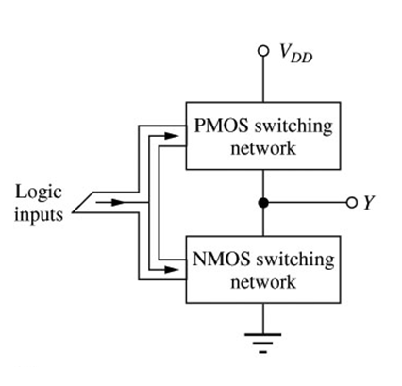


CMOS Logic Design
The design of logic gates for CMOC inverter is different from the similar logic design for NMOS inverters that we considered earlier.
For NMOS gates, the logic involved only the switching transistor.
For CMOS, both transistors are involved, since the input affects both in symmetrical way.
Thus, for each logic input variable in CMOS gate there is one transistor in NMOS network and one transistor in PMOS network.
Load transistor
NMOS logic gate structure
CMOS logic gate structure

Slide 28
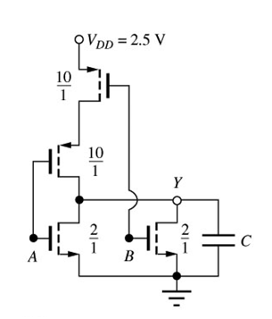
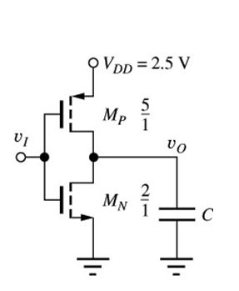
CMOS NOR Gate
A
Reference Inverter
CMOS NOR 2 input gate

Slide 29
CMOS NOR Gate
For the two input NOR gate, the NMOS portion of the gate is identical to the NMOS gate.
A
Reference Inverter
CMOS NOR 2 input gate

Slide 30
CMOS NOR Gate
For the two input NOR gate, the NMOS portion of the gate is identical to the NMOS gate.
In the CMOS gate, we must ensure that static current path does not exist through the logic gate, and this requires switching also in the PMOS transistor network → 2 PMOS transistors.
A
Reference Inverter
CMOS NOR 2 input gate

Slide 31
CMOS NOR Gate
For the two input NOR gate, the NMOS portion of the gate is identical to the NMOS gate.
In the CMOS gate, we must ensure that static current path does not exist through the logic gate, and this requires switching also in the PMOS transistor network → 2 PMOS transistors.
In the NMOS section, the conducting path exists for A=1 or B=1.
A
Reference Inverter
CMOS NOR 2 input gate
A=1
Y=0

Slide 32
CMOS NOR Gate
For the two input NOR gate, the NMOS portion of the gate is identical to the NMOS gate.
In the CMOS gate, we must ensure that static current path does not exist through the logic gate, and this requires switching also in the PMOS transistor network → 2 PMOS transistors.
In the NMOS section, the conducting path exists for A=1 or B=1.
A
Reference Inverter
CMOS NOR 2 input gate
A=1
Y=0
A=1
Y=0
B=1

Slide 33
CMOS NOR Gate
For the two input NOR gate, the NMOS portion of the gate is identical to the NMOS gate.
In the CMOS gate, we must ensure that static current path does not exist through the logic gate, and this requires switching also in the PMOS transistor network → 2 PMOS transistors.
In the NMOS section, the conducting path exists for A=1 or B=1.
In the PMOS section, the conducting path exists only when A=0 and B=0
A
Reference Inverter
CMOS NOR 2 input gate
A=1
Y=0
A=1
Y=0
A=0
Y=1
B=1

Slide 34
CMOS NOR Gate
For the two input NOR gate, the NMOS portion of the gate is identical to the NMOS gate.
In the CMOS gate, we must ensure that static current path does not exist through the logic gate, and this requires switching also in the PMOS transistor network → 2 PMOS transistors.
In the NMOS section, the conducting path exists for A=1 or B=1.
In the PMOS section, the conducting path exists only when A=0 and B=0
A
Reference Inverter
CMOS NOR 2 input gate
A=1
Y=0
A=1
Y=0
A=0
Y=1
B=1
A=0 & B=0
Y=1

Slide 35
CMOS NOR Gate
For the two input NOR gate, the NMOS portion of the gate is identical to the NMOS gate.
In the CMOS gate, we must ensure that static current path does not exist through the logic gate, and this requires switching also in the PMOS transistor network → 2 PMOS transistors.
In the NMOS section, the conducting path exists for A=1 or B=1.
In the PMOS section, the conducting path exists only when A=0 and B=0
Complimentary nature of conducting paths: for NMOS – parallel
A
Reference Inverter
CMOS NOR 2 input gate
A=1
Y=0
A=1
Y=0
A=0
Y=1
B=1
A=0 & B=0
Y=1

Slide 36
CMOS NOR Gate
For the two input NOR gate, the NMOS portion of the gate is identical to the NMOS gate.
In the CMOS gate, we must ensure that static current path does not exist through the logic gate, and this requires switching also in the PMOS transistor network → 2 PMOS transistors.
In the NMOS section, the conducting path exists for A=1 or B=1.
In the PMOS section, the conducting path exists only when A=0 and B=0
Complimentary nature of conducting paths: for NMOS – parallel, for PMOS - series
A
Reference Inverter
CMOS NOR 2 input gate
A=1
Y=0
A=1
Y=0
A=0
Y=1
B=1
A=0 & B=0
Y=1

Slide 37
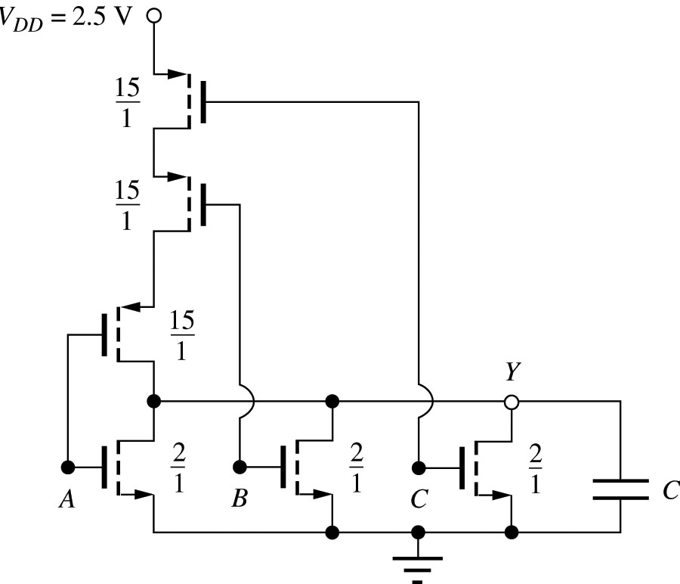
CMOS NOR Gate
For the two input NOR gate, the NMOS portion of the gate is identical to the NMOS gate.
In the CMOS gate, we must ensure that static current path does not exist through the logic gate, and this requires switching also in the PMOS transistor network → 2 PMOS transistors.
In the NMOS section, the conducting path exists for A=1 or B=1.
In the PMOS section, the conducting path exists only when A=0 and B=0
Complimentary nature of conducting paths: for NMOS – parallel, for PMOS - series
A
Reference Inverter
CMOS NOR 2 input gate
A=1
Y=0
A=1
Y=0
A=0
Y=1
B=1
CMOS NOR 3 input gate
A=0 & B=0
Y=1

Slide 38
CMOS NOR Gate
A | B | Y
0 | 0 | 1
0 | 1 | 0
1 | 0 | 0
1 | 1 | 0

Slide 39
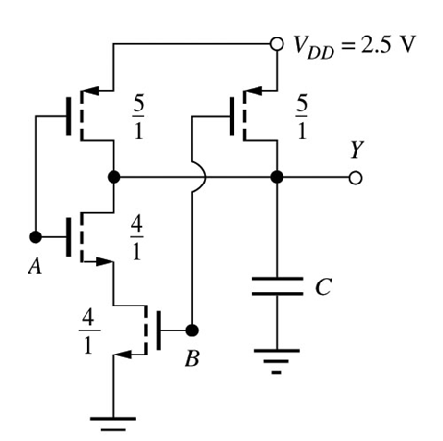
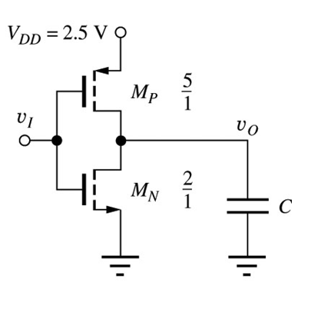
CMOS NAND Gates
Y
A
Reference Inverter
CMOS NAND gate

Slide 40
CMOS NAND Gates
Y
A
A=0
Y=1
Reference Inverter
A=0
Y=1
B=0
Y=1
CMOS NAND gate

Slide 41
CMOS NAND Gates
Y
A
Reference Inverter
A=1
Y=0
CMOS NAND gate
A=1 & B=1
Y=0

Slide 42
CMOS NAND Gates
Y
A
A=0
Y=1
Reference Inverter
A=0
Y=1
B=0
Y=1
A=1
Y=0
CMOS NAND gate
A=1 & B=1
Y=0

Slide 43
CMOS NAND Gates
Y
A
Reference Inverter
CMOS NAND gate
The same rules apply for sizing the NAND gate devices as for the NOR gate, except now the NMOS transistors are in series
(W/L)_{P} will be the same size of that of the reference inverter

Slide 44
CMOS NAND Gates
Y
A
Reference Inverter
CMOS NAND gate
The same rules apply for sizing the NAND gate devices as for the NOR gate, except now the NMOS transistors are in series
(W/L)_{P} will be the same size of that of the reference inverter
(W/L)_{N} will be twice the size of that of the reference inverter

Slide 45
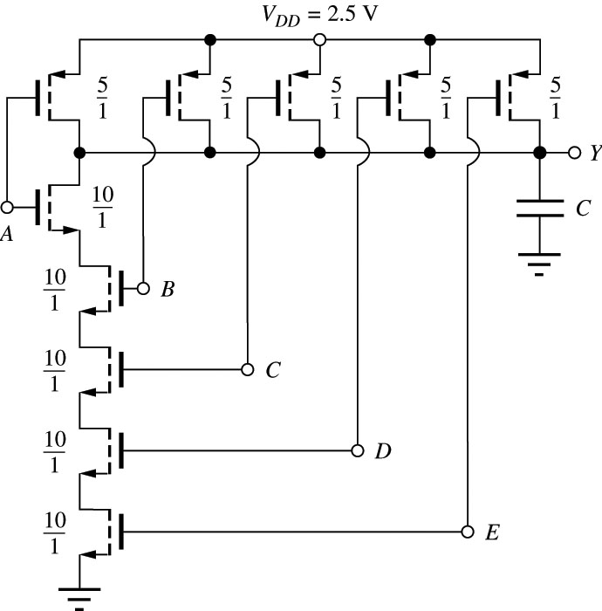
Multi-Input CMOS NAND Gates

Slide 46
CMOS NAND Gate
A | B | Y
0 | 0 | 1
0 | 1 | 1
1 | 0 | 1
1 | 1 | 0
OFF
ON
OFF
OFF
OFF
ON
ON
ON
1
1
0
0
ON
ON
OFF
OFF
1
0
1
0
ON
OFF
ON
OFF

